Slide 1
Mechanisms and Robotics Laboratory Exercises - Day 3

Slide 2
Contents
Exercises Day - 3
Inverse Kinematics of a 2dof Planar Robot
Inverse Kinematics of a 3dof Cylindrical Robot
Inverse Kinematics of a 3dof Polar Robot
Inverse Kinematics of a 3 dof Articulated Robot
Notes:
References:
https://opentextbc.ca/teachinginadigitalage/chapter/section-8-1-a-short-history-of-educational-technology/?utm_source=timminstoday.com&utm_campaign=timminstoday.com&utm_medium=referral
https://www.riemysore.ac.in/ict/unit__7__elearning.html#7.5
https://www.youtube.com/watch?v=jTH3ob1IRFo
Skinner, B. (1968) The Technology of Teaching, 1968. New York: Appleton-Century-Crofts

Slide 3
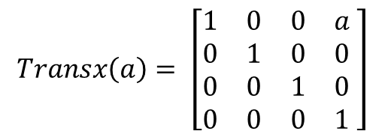
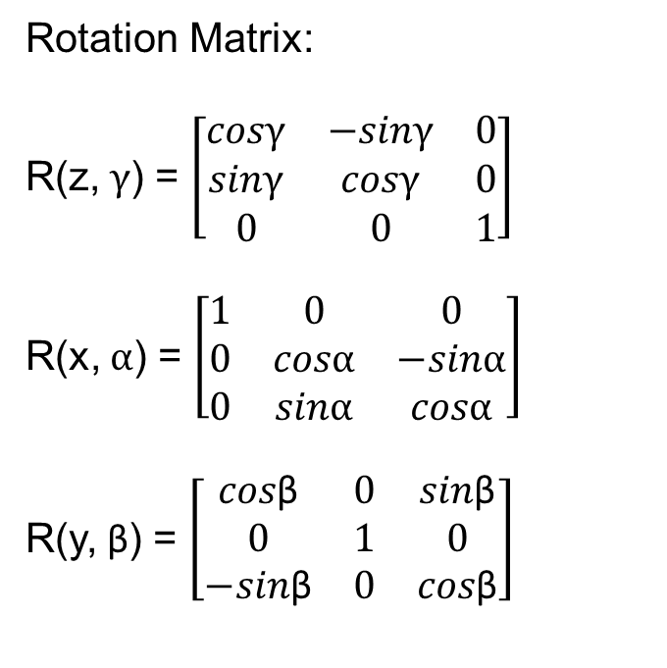
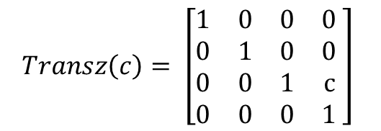
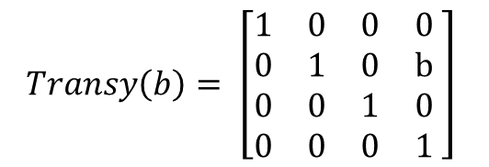
Solution
Rotation Matrix:
R(z, $γ$) = $\left[\begin{matrix}cosγ & −sinγ & 0 \\ sinγ & cosγ & 0 \\ 0 & 0 & 1\end{matrix}\right]$
R(x, $α$) = $\left[\begin{matrix}1 & 0 & 0 \\ 0 & cosα & −sinα \\ 0 & sinα & cosα\end{matrix}\right]$
R(y, β) = $\left[\begin{matrix}cos\text{β} & 0 & sin\text{β} \\ 0 & 1 & 0 \\ −sin\text{β} & 0 & cos\text{β}\end{matrix}\right]$
$$Transx\left(a\right)= \left[\begin{matrix}1 & 0 & 0 & a \\ 0 & 1 & 0 & 0 \\ 0 & 0 & 1 & 0 \\ 0 & 0 & 0 & 1\end{matrix} \right]$$
$$Transy\left(b\right)= \left[\begin{matrix}1 & 0 & 0 & 0 \\ 0 & 1 & 0 & b \\ 0 & 0 & 1 & 0 \\ 0 & 0 & 0 & 1\end{matrix} \right]$$
$$Transz\left(c\right)= \left[\begin{matrix}1 & 0 & 0 & 0 \\ 0 & 1 & 0 & 0 \\ 0 & 0 & 1 & c \\ 0 & 0 & 0 & 1\end{matrix} \right]$$

Slide 4
Inverse Kinematics of a Planar Arm

Slide 5
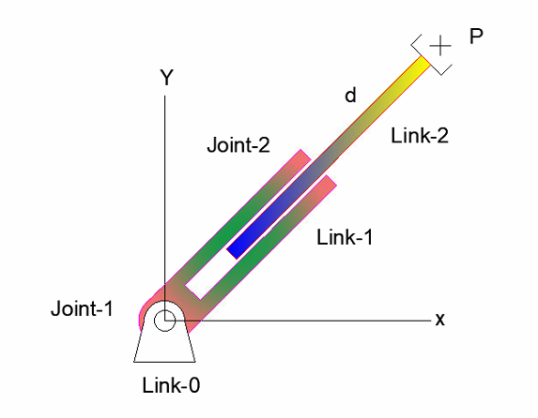
Problem No. 3
Given Point P = [650;300] find the joint parameters, θ, q1 if the Link length is L1 = 500mm for the planar robot shown in the figure.

Slide 6
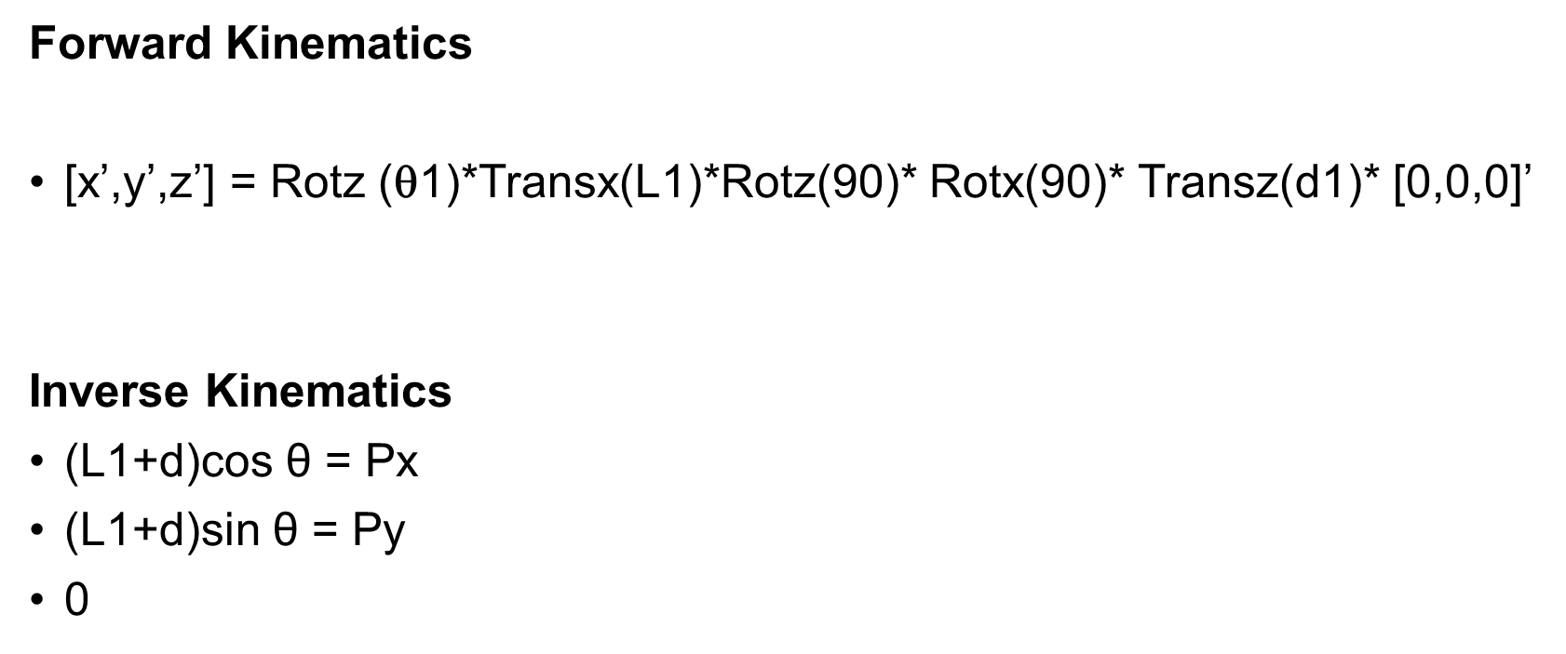
Solution
Forward Kinematics
[x’,y’,z’] = Rotz (θ1)*Transx(L1)*Rotz(90)* Rotx(90)* Transz(d1)* [0,0,0]’
Inverse Kinematics
(L1+d)cos $\text{θ}$ = Px
(L1+d)sin $\text{θ}$ = Py
0

Slide 7
% 2 dof Planar Manipulator
L1 = 500
P = [650;300;0]
theta =atand(P(2)/P(1))
d = (P(1)/cosd(theta))- L1

Slide 8
Inverse Kinematics of a 3dof Cylindrical Robot

Slide 9
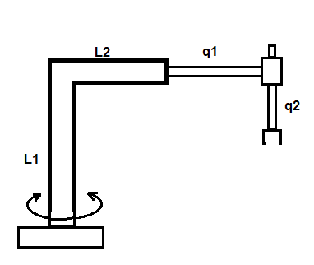
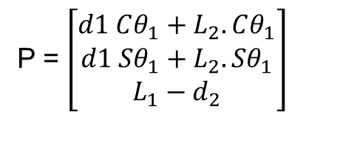
Cylindrical arm
Problem No. 5
Given Point P = [424.2641;424.2641;300] find the joint parameters, θ, q1, q2, if the Link lengths are L1 = 500mm, L2 = 300mm for the cylindrical robot shown.
P = $\left[\begin{matrix}d1 Cθ_{1}+L_{2}.Cθ_{1} \\ d1 Sθ_{1}+L_{2}.Sθ_{1} \\ L_{1}−d_{2}\end{matrix}\right]$

Slide 10
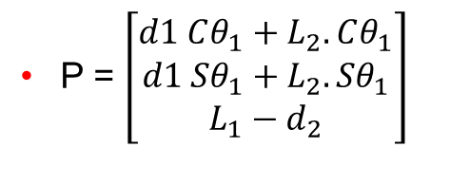
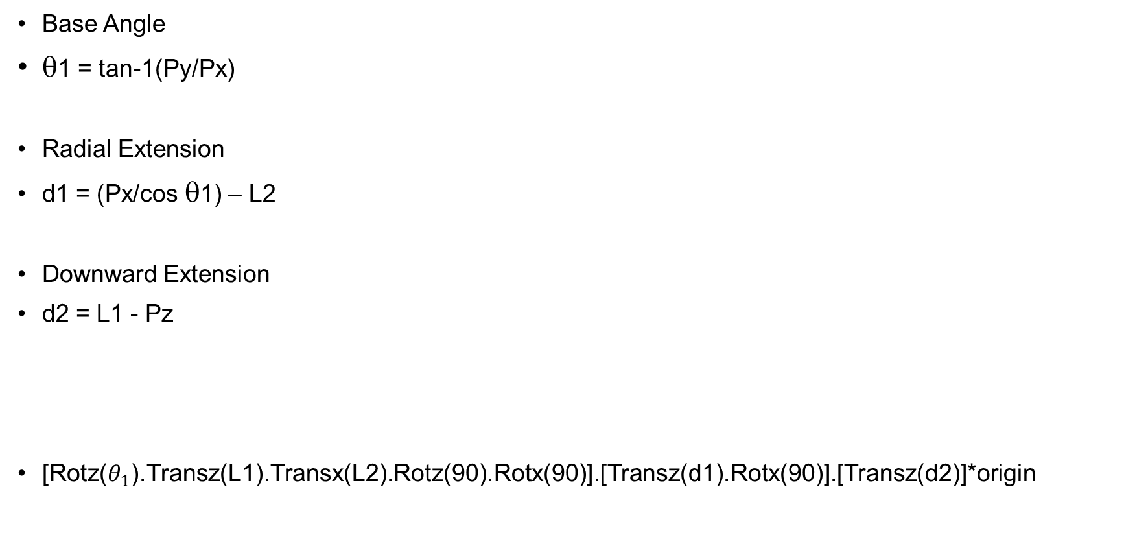
Base Angle
θ1 = tan-1(Py/Px)
Radial Extension
d1 = (Px/cos θ1) – L2
Downward Extension
d2 = L1 - Pz
[Rotz($θ_{1}$).Transz(L1).Transx(L2).Rotz(90).Rotx(90)].[Transz(d1).Rotx(90)].[Transz(d2)]*origin
P = $\left[\begin{matrix}d1 Cθ_{1}+L_{2}.Cθ_{1} \\ d1 Sθ_{1}+L_{2}.Sθ_{1} \\ L_{1}−d_{2}\end{matrix}\right]$

Slide 11
MATLAB Code:
clear all
P = [424.2641;424.2641;300]
origin = [0,0,0,1]'
L1 = 500
L2 = 300
theta1 = atand(P(2)/P(1))
d1 = (P(1)/cosd(theta1)) - L2
d2 = L1 - P(3)

Slide 12
Inverse Kinematics of a 3dof Polar Robot

Slide 13
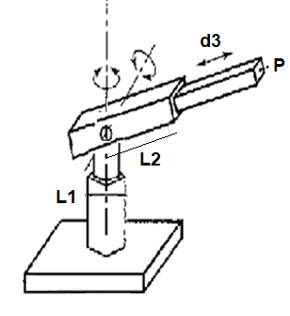
Problem No. 4
Find the joint angles and extension d3 for the tool point P(650,150,350)
L1 = 250 mm
L2= 500 mm

Slide 14
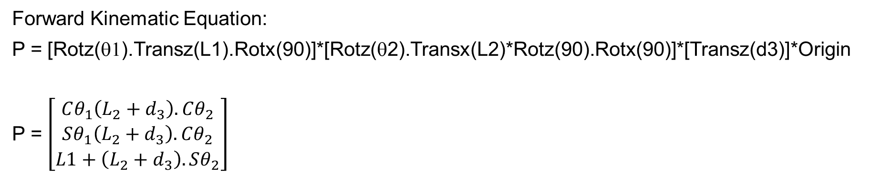
Forward Kinematic Equation:
P = [Rotz(θ1).Transz(L1).Rotx(90)]*[Rotz(θ2).Transx(L2)*Rotz(90).Rotx(90)]*[Transz(d3)]*Origin
P = $\left[\begin{matrix}Cθ_{1}\left(L_{2}+d_{3}\right).Cθ_{2} \\ Sθ_{1}\left(L_{2}+d_{3}\right).Cθ_{2} \\ L1+\left(L_{2}+d_{3}\right).Sθ_{2}\end{matrix}\right]$

Slide 15
L1 = 250
L2 = 500
theta1 = atand(Py/Px)
theta2 = atand((Pz-L1)/(Py/sind(theta1)))
d3 = (Px/(cosd(theta1)*cosd(theta2)))-L2

Slide 16
Polar Sequence
clear all
P = [650,150,250;550,300,200;450,150,350]
L1 = 250
L2 = 500
origin = [0,0,0,1]'
for i = 1:3
Px = P(i,1)
Py = P(i,2)
Pz = P(i,3)
[theta1,theta2,d3] = polar_inv(Px,Py,Pz)
x1 = origin
x2 = rotz(theta1)*transz(L1)*rotx(90)*origin
x3 = [rotz(theta1)*transz(L1)*rotx(90)]*[rotz(theta2)*transx(L2)*rotz(90)*rotx(90)]*origin
x4 = [rotz(theta1)*transz(L1)*rotx(90)]*[rotz(theta2)*transx(L2)*rotz(90)*rotx(90)]*[transz(d3)]*origin
X = [x1(1),x2(1),x3(1),x4(1)]
Y = [x1(2),x2(2),x3(2),x4(2)]
Z = [x1(3),x2(3),x3(3),x4(3)]
%plot3(X,Y,Z,'y-','LineWidth',2,X,Y,Z,'go')
plot3(X,Y,Z,'-rs','LineWidth',8,...
'MarkerEdgeColor','k',...
'MarkerFaceColor','g',...
'MarkerSize',15)
hold on
end

Slide 17
Inverse Kinematics of a 3dof Articulated Robot

Slide 18
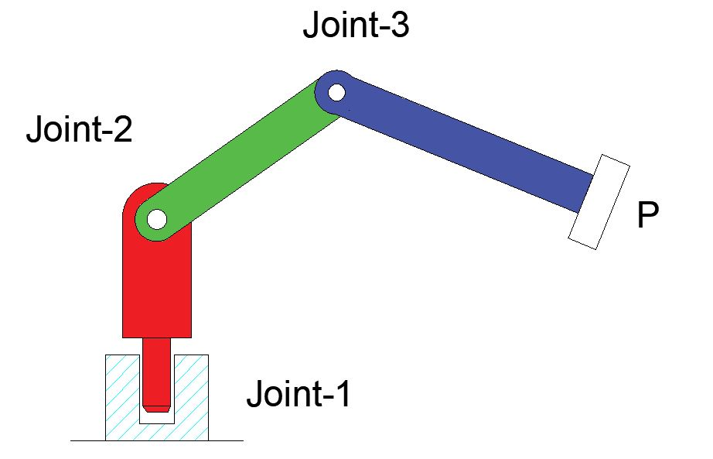
3 dof Articulated manipulator
Problem No. 6
Develop workspace points in MATLAB for articulated manipulator whose joint angles are π, π/2 and π/2, link lengths L1 = 100mm, L₂=L₃=300 mm.

Slide 19
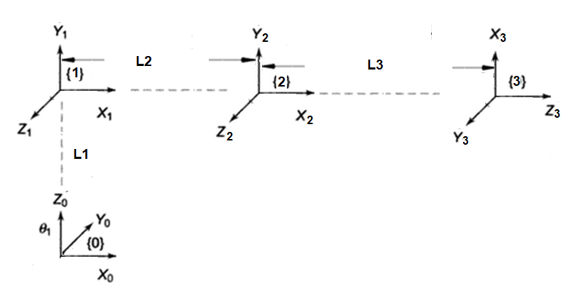
Link i | θ | d | α | a | Home
1 | θ1 | L1 | 90
2 | θ2 |  |  | L2
3 | θ3 |  | 90 | L3 | 90

Slide 20
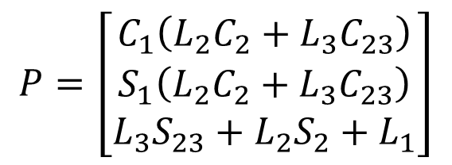
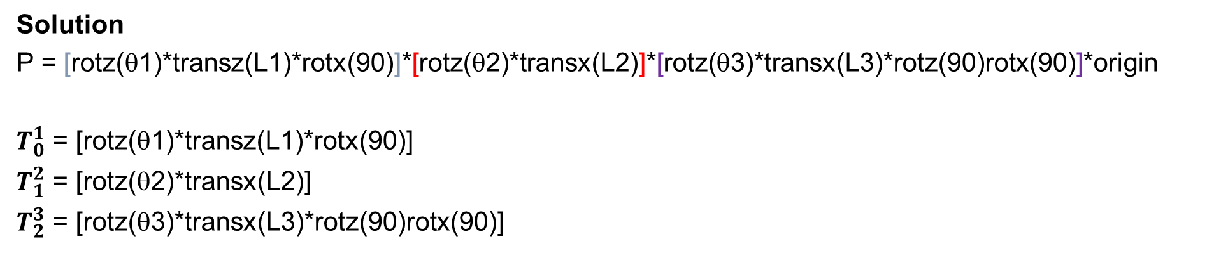
Solution
P = [rotz(θ1)*transz(L1)*rotx(90)]*[rotz(θ2)*transx(L2)]*[rotz(θ3)*transx(L3)*rotz(90)rotx(90)]*origin
$T_{0}^{1}$ = [rotz(θ1)*transz(L1)*rotx(90)]
$T_{1}^{2}$ = [rotz(θ2)*transx(L2)]
$T_{2}^{3}$ = [rotz(θ3)*transx(L3)*rotz(90)rotx(90)]
Link i | θ | d | α | a | Home
1 | θ1 | L1 | 90
2 | θ2 |  |  | L2
3 | θ3 |  | 90 | L3 | 90
$$P=\left[\begin{matrix}C_{1}\left(L_{2}C_{2}+L_{3}C_{23}\right) \\ S_{1}\left(L_{2}C_{2}+L_{3}C_{23}\right) \\ L_{3}S_{23}+L_{2}S_{2}+L_{1}\end{matrix}\right]$$

Slide 21
Inverse Kinematics of a 3 dof Articulated arm
function [theta1,theta2,theta3] = articulated_inv(Px,Py,Pz)
P = [Px;Py;Pz]
origin = [0,0,0,1]'
L1 = 200
L2 = 500
L3 = 350
theta1 = atand(P(2,1)/P(1,1))
J2 = rotz(theta1)*transz(L1)*origin
C = sqrt((P(1)-J2(1))^2 + (P(2)-J2(2))^2 + (P(3)-J2(3))^2)
theta3 = -acosd((C*C -L2*L2 - L3*L3)/(2*L2*L3))
a = C
A = pi + (theta3*pi/180)
B = asind(L3/(a/sin(A)))
e = asind((P(3)-J2(3))/C)
theta2 = (B+e)
end

Slide 22
Navigating through a sequence of points
clear all
P = [683,283,480;500,250,220;300,150,220]
L1 = 200
L2 = 500
L3 = 350
origin = [0,0,0,1]'
for i = 1:3
Px = P(i,1)
Py = P(i,2)
Pz = P(i,3)
[theta1,theta2,theta3] = articulated_inv(Px,Py,Pz)
x1 = origin
x2 = [rotz(theta1)*transz(L1)*rotx(90)]*origin
x3 = [rotz(theta1)*transz(L1)*rotx(90)]*[rotz(theta2)*transx(L2)]*origin
x4 = [rotz(theta1)*transz(L1)*rotx(90)]*[rotz(theta2)*transx(L2)]*[rotz(theta3)*transx(L3)*rotz(90)*rotx(90)]*origin
X = [x1(1),x2(1),x3(1),x4(1)]
Y = [x1(2),x2(2),x3(2),x4(2)]
Z = [x1(3),x2(3),x3(3),x4(3)]
plot3(X,Y,Z,'-rs','LineWidth',8,...
'MarkerEdgeColor','k',...
'MarkerFaceColor','g',...
'MarkerSize',15)
hold on
end

